Slide 1
Analyzing the Accessibility of Sports Facilities in Missoula, MT
Quinn Peacock

Slide 2
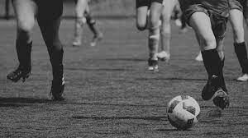
Agenda
Introduction
The Missoula Area
Public Opinion
Take-Aways

Slide 3
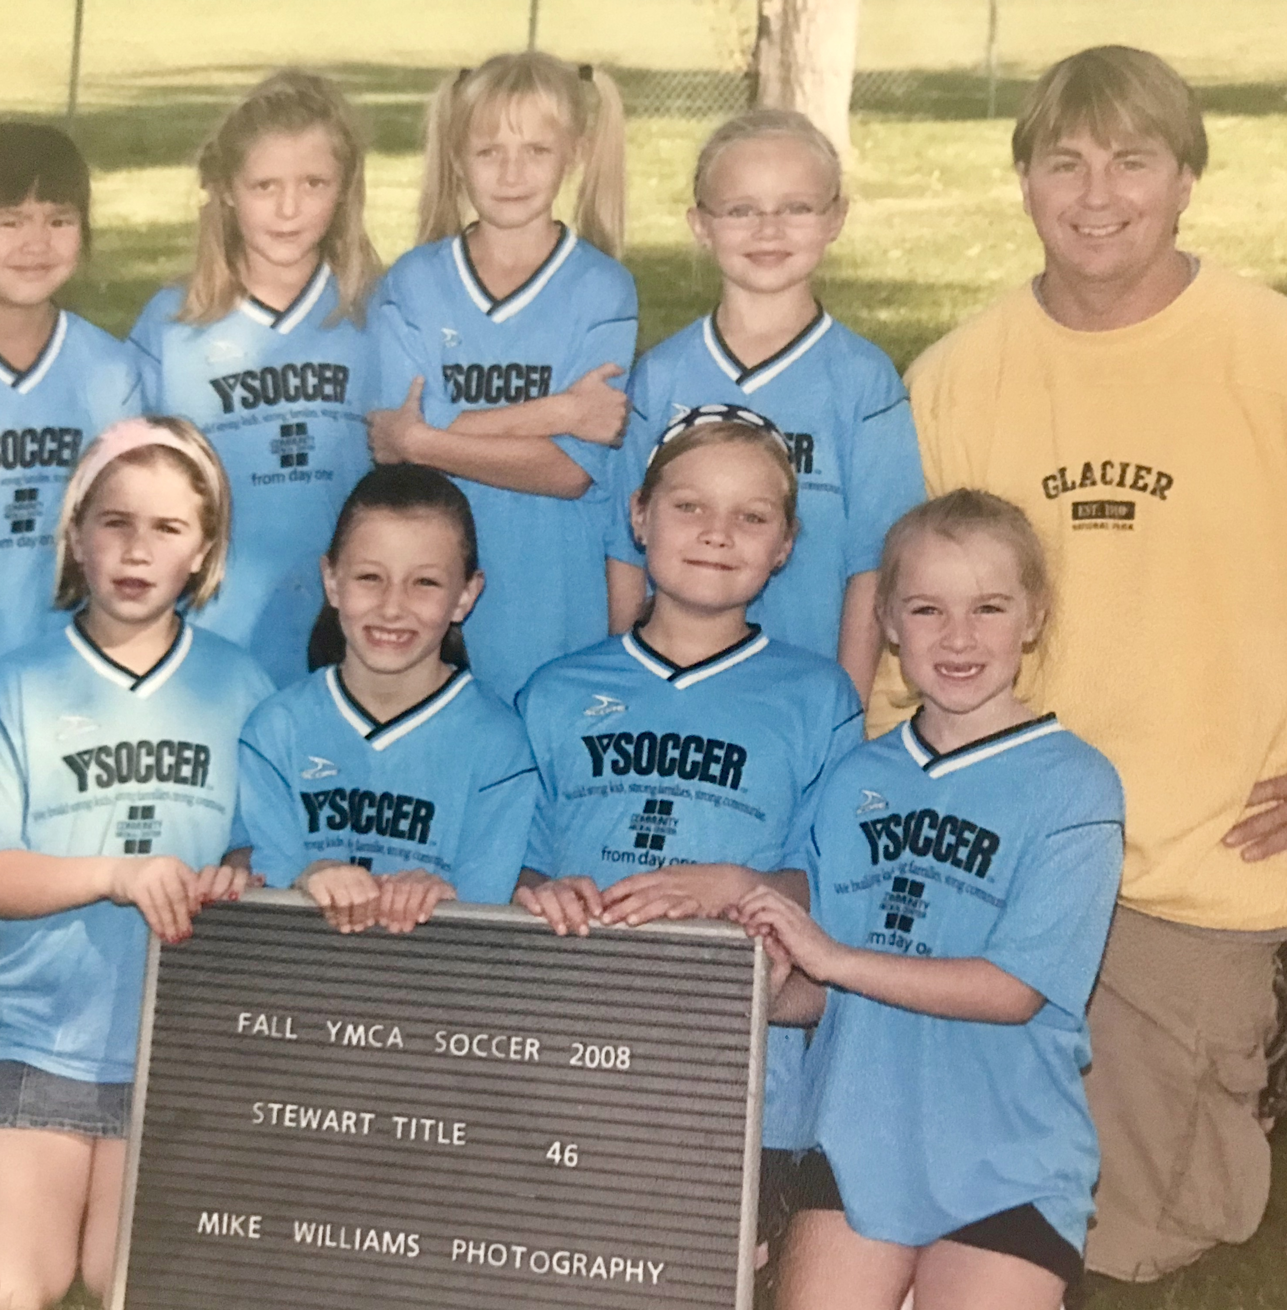
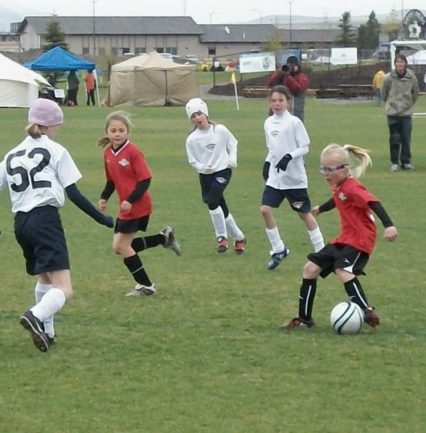
About This Project
This is my Honors Thesis Project
Soccer in Missoula has been my life since I can remember
The community around soccer here is why I want to do what I can to give back.

Slide 4
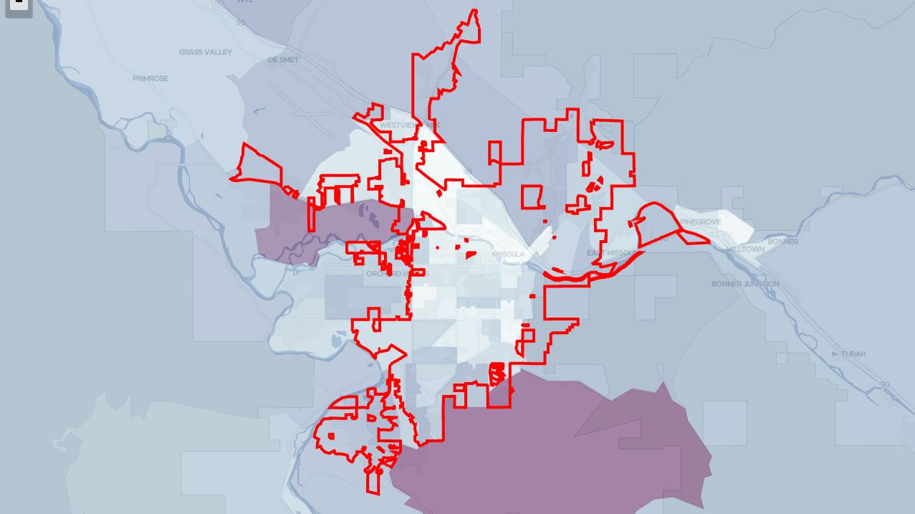
Median Household Income
Notes:
Area of Missoula that has a median household income under $50,000, household income is averaged within each census block 2000 through 2020

Slide 5
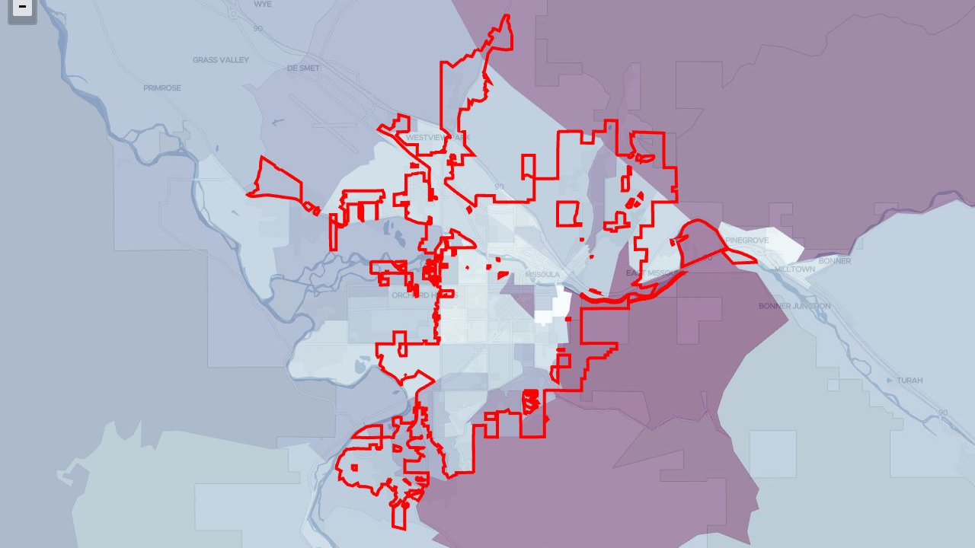
Median Per Capita Income
Notes:
Area of Missoula that has a median per capita income under $30,000, same data source as previous slide

Slide 6
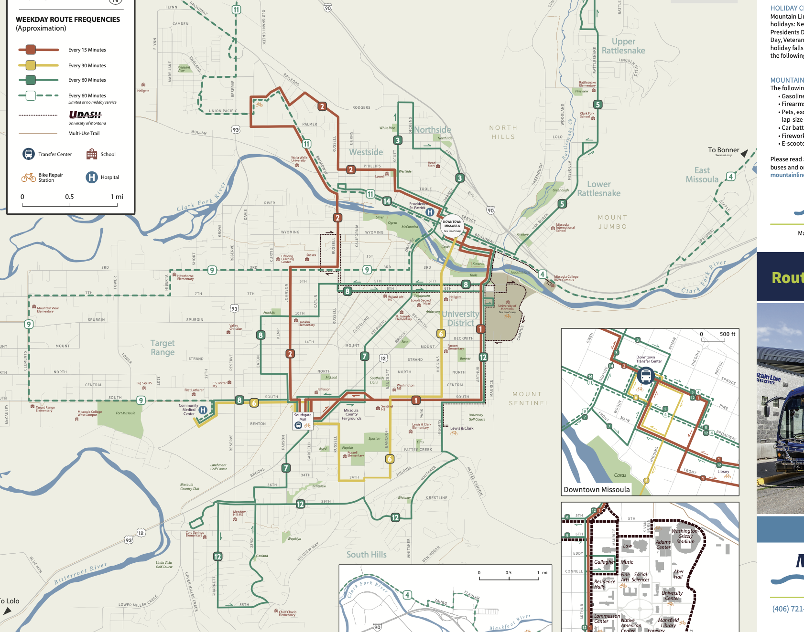
Public Transportation
Notes:
Mountain Line routes in Missoula , most are within the lower income area of Missoula which is good for increasing accessiblilty

Slide 7
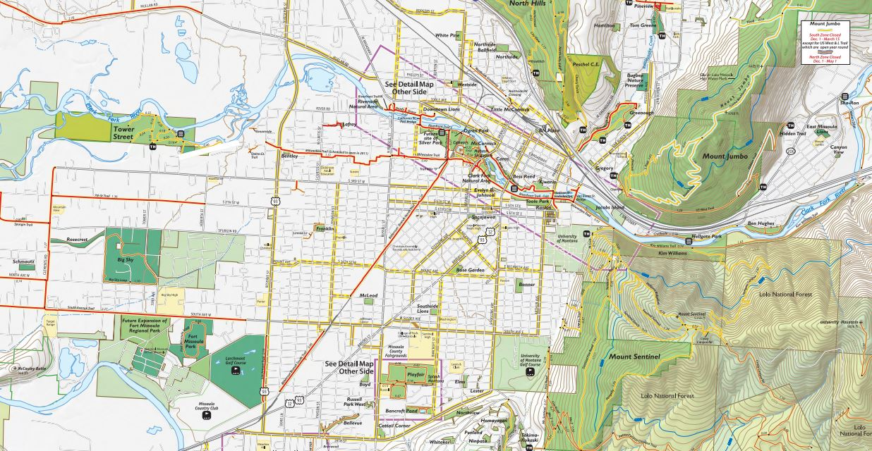
Parks and Public Schools
Notes:
Parks: Bentley, Silver Park, Franklin, Mcleod, RailLink Schools: Loyola, MIS, Franklin, Jefferson

Slide 8
Survey Overview

Slide 9
Availability/Accessibility

Slide 10
Free Response Questions
What is Missoula missing in terms of recreational soccer?
What do you want to see improve in terms of public sports facilities in Missoula?
More indoor or year-round spaces
Free to use fields
Fields that are closer to central Missoula, more bike accessible

Slide 11
Takeaways
Pick-up soccer doesn’t seem to be a high priority to most people.
There would be more interest if there was a space and knowledge.
Missoula is in need of a year-round place to play that is free and easier to manage than the turf field at Fort Missoula.
Locations in the center of Missoula would be the best in terms of accessibility.

Slide 12
Recommended Area of Focus

Slide 13
Other Observations
Rec league or pick up games that are specific to age
Soccer is Not the only sport struggling with facilities, involvement, organization etc.

Slide 14
Thank you
Questions ?

